Slide 1
Introduction to Internet

Slide 2
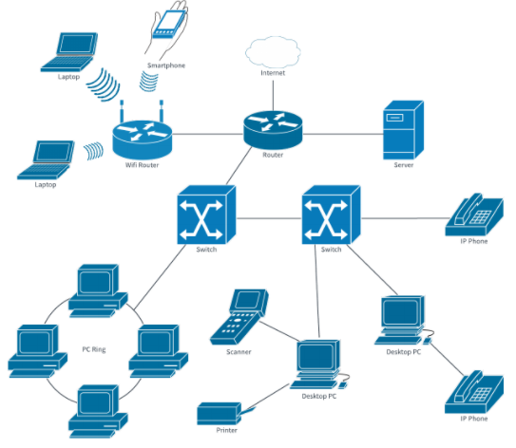
What is internet?
Network of networks.

Slide 3
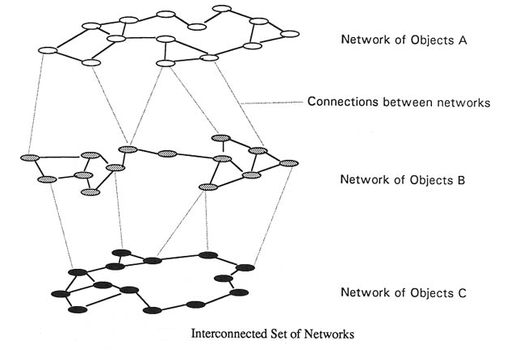
Interconnected set of Networks

Slide 4
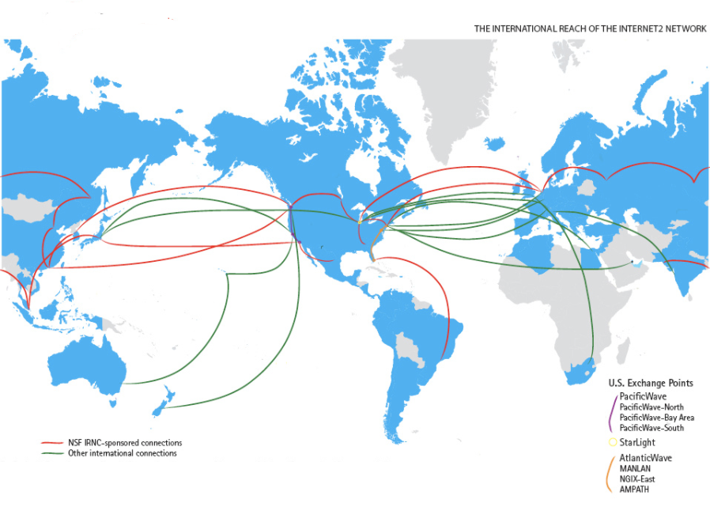
World Internet Connectivity

Slide 5
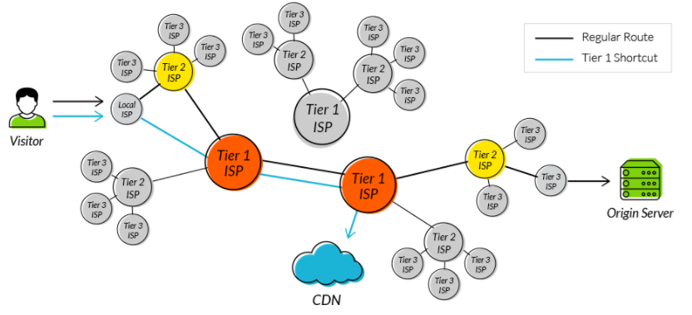
ISP(Internet Service Providers)

Slide 6
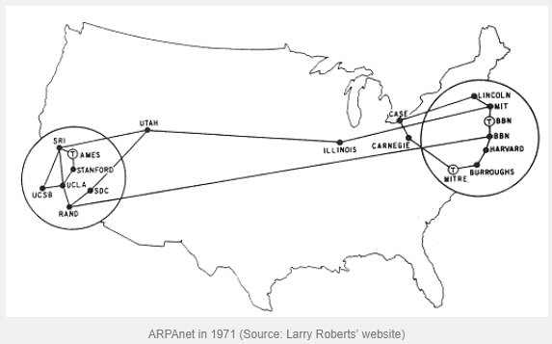
Evolution of Internet
1959, ARPANET formed(American Research Project Agency Network) by USA government fund to develop new technology projects for defense.
Objective of the ARPANET, collaboration of work on Scientific and Research Projects from various locations.

Slide 7
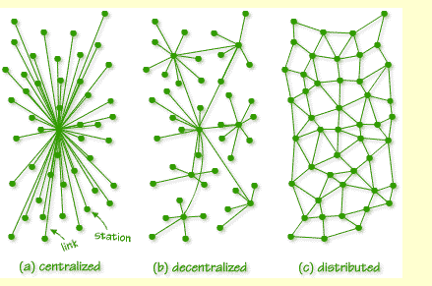
Paul Baran’s Idea of Distributed Network

Slide 8
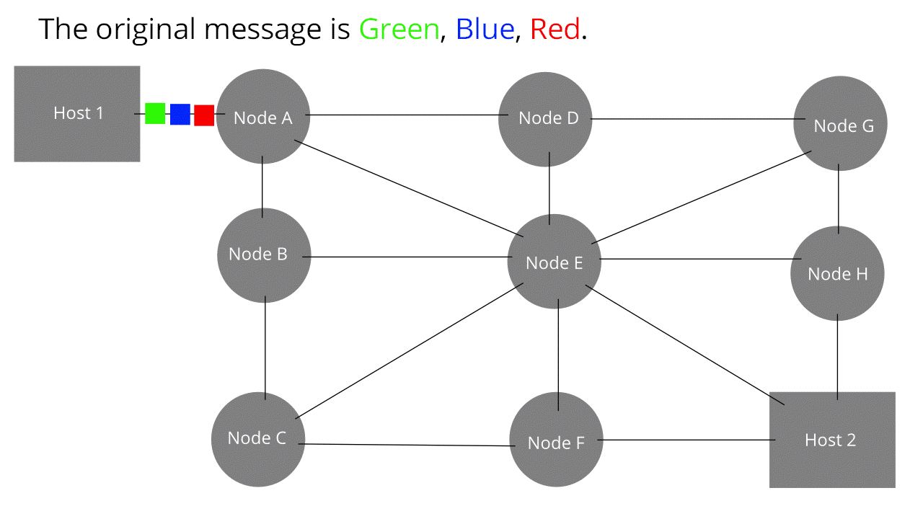
Packet Switching:

Slide 9
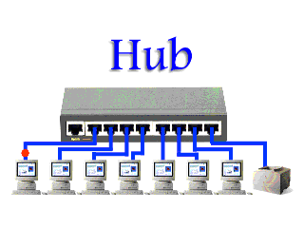
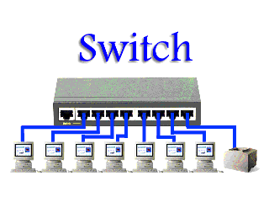

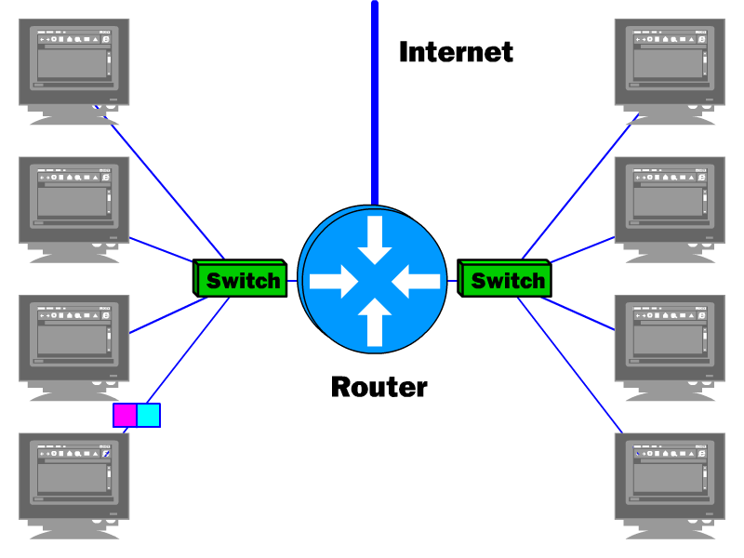
Important Devices in Internet Connectivity

Slide 10
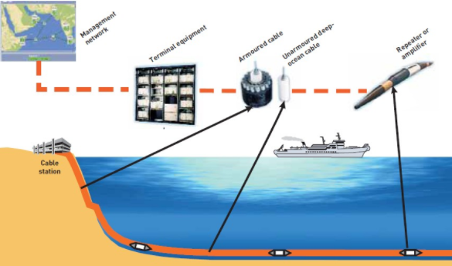
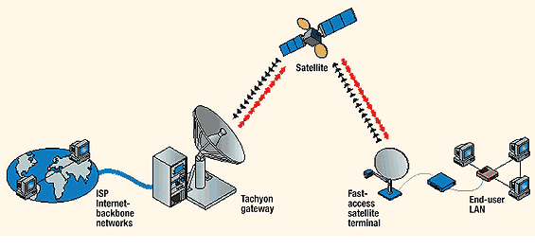

Slide 11
Cyber Security(Internet Security)
Means Avoiding attacks in Internet

Slide 12
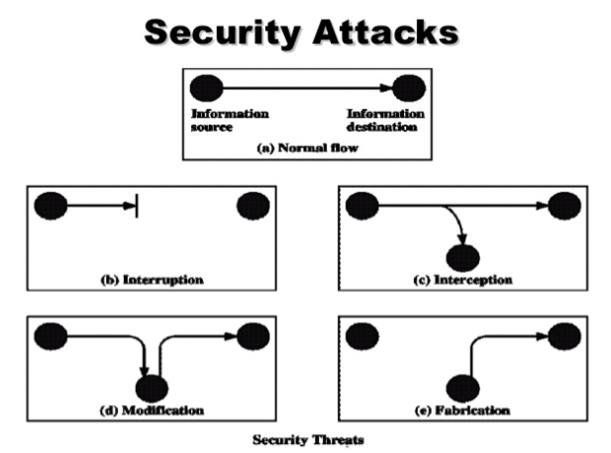
Internet security attacks
Interruption
Interception
Modification
Fabrication

Slide 13
Normal Data Flow
Message
Sender Receiver
S
R

Slide 14
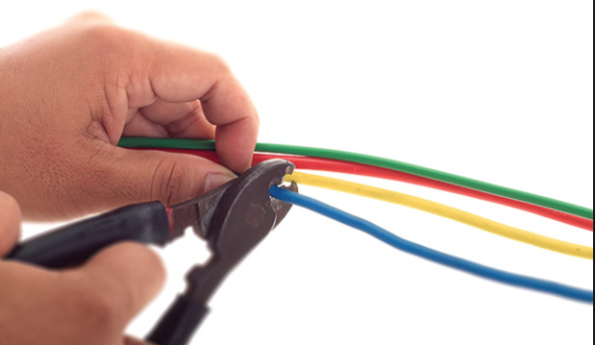
Interruption (attack on availability)

Slide 15
Message
Sender Receiver
An asset of the system is destroyed or becomes unavailable or unusable.
Examples:
1) Destruction of some Hardware
2) Jamming Wireless Signal
3) Disable File Management System
S
R

Slide 16

Interception (attack on confidentiality)

Slide 17
Message
Sender Receiver
Hacker
An unauthorized party gains access to an asset.
Examples:
1) Wire tapping to capture data in a network
2) Illicitly copying data or programs
3) Eavesdropping(intermediate listening phone call, instance message, video conference or Fax)
S
R
H

Slide 18
Modification (attack on integrity)
Sender Receiver
you are good you are bad
Hacker
When an unauthorized party gains access and tampers an asset.
Examples:
1) Changing data file
2) Altering a program and the contents of a message
S
R
H

Slide 19
Fabrication(attack on Authenticity)
Sender Receiver
inserts counterfeit
Hacker
An unauthorized party inserts a counterfeit object into the system. Attack on Authenticity. Also called impersonation.
Examples:
1) Hackers gaining access to a personal email and sending message
2) Insertion of records in data files
3) Insertion of spurious (fake) messages in a network
S
R
H

Slide 20
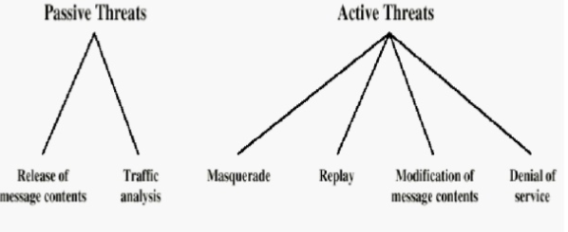
Passive vs Active Attack
Passive Attack: Eavesdropping information with out modifying it (Difficult to detect)
Active Attack: Involve Modification, Creation of false information.

Slide 21
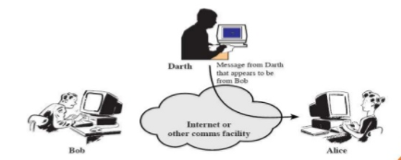
Release of message: interception of telephonic conversation, an E-mail messages or a transferred file may contain confidential data.
Traffic Analysis: It is the process of intercepting and examining messages in order to deduce information from patterns in communication
Masquerading :It is attack on authenticity. It is fabrication on information instead of actual user. Attacker login in to the system with stolen user credentials(user name and password)

Slide 22
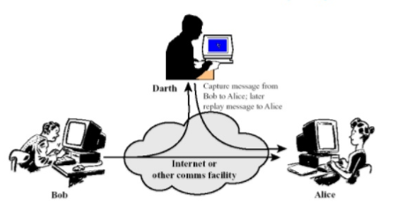
Reply: Capturing of data unit and retransmitting to produce un authorize effects.
Modification of Message Content: Inserting the fake data as data source.

Slide 23
Denial of Service: Hijacking Network, or Source Host Server, making host server busy.

Slide 24
Security Services
Objective of Security Services is Right Information to Right Person(Party).
Security Services are
Confidentiality
Authentication
Integrity
Non-repudiation
Access Control
Availability

Slide 25

Confidentiality
Confidentiality is the protection of personal information. Confidentiality means keeping a client’s information between you and the client, and not telling others including co-workers.
Examples:
All financial statements are password protection documents.
Bank statements are password protected.

Slide 26
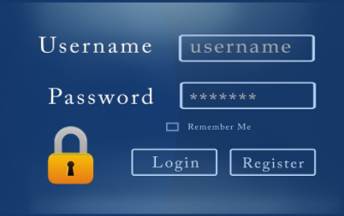
Authentication
Process of validating user while accessing assets or resources is called as authentication.

Slide 27
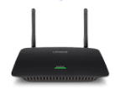
Integrity
Integrity refers to methods of ensuring that the data is real, accurate and safeguard from un authorized users modifications.
Intermediate devices(parties) responsible to deliver to destination, what they receive.
1+1=2 1+1=2
S
R

Slide 28

Non-repudiation
Nonrepudiation is the assurance that someone can not deny something. Typically nonrepudiation refers to the ability to ensure that a party to a contract or communication can not deny the authentication of their signature on a document or the sending message that they originated.
denial of the truth or validity of something.

Slide 29




Access Control
Selective Restriction of access to a place or other resources.
Examples:
1) Debit or Credit card Swiping Machine
2) Thumb Impression to validation of identity
3) Door Access Card
4) Face Recognition in iPhone X

Slide 30

Availability
Availability means that information is accessible by authorized users.

Slide 31

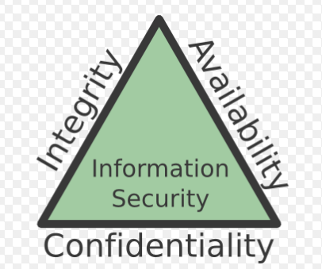
CAI Triad
Confidentiality, integrity and availability, also known as the CIA triad, is a model designed to guide policies for information security within an organization. The model is also sometimes referred to as the AIC triad

Slide 32

Confidentiality: Protecting information from un-authorized parties.
Protecting information by various ways
Data Encryption is common method of ensuring confidentiality
Authentication(Login validation of user when accessing it)
Biometric verification
Security Tokens (Movie tickets )
Soft Tokens
Integrity: Integrity of information refers to protecting information from being modified by unauthorized parties.
By applying permissions on file access.

Slide 33
Availability: Make sure information is available always to the right parties(person or System).
Availability by various methods:
Availability of hardware
Availability of Software
Availability of Intermediate Devices like Routers, Switches, Network
Most of the Availability concepts will cover in Cloud Computing ( Scale up/Scale down) pay by use.

Slide 34
Security Mechanisms (X.800)
A mechanism that is designed to detect, prevent, or recover from a security attack.
Security Mechanisms
Specific Security Mechanism
Pervasive Security Mechanism
Encipherment
Trusted Functionality
Digital Signatures
Access Controls
Security Labels
Data Integrity
Event Detection
Authentication Exchange
Security Audit Trail
Security Recovery
Routing Control
Notarization

Slide 35
Specific Security Mechanism
Implemented on Specific Layer of OSI Model
Encipherment: Encrypting data before sending through communication channel and decrypting after receiving at destination.
Digital Signature: append digital signature to the data before transferring and verify the signature at destination to avoid forgery.
Access Control: A variety of techniques used for enforcing access permissions to the system resources.
Data Integrity: A variety of mechanisms used to assure the integrity of a data unit or stream of data units.
Authentication Exchange: A mechanism intended to ensure the identity of an entity by means of information exchange.
Traffic Padding: The insertion of bits into gaps in a data stream to frustrate traffic analysis attempts.
Routing Control: Enables selection of particular physically secure routes for certain data and allows routing changes once a breach of security is suspected.
Notarization: The use of a trusted third party to assure certain properties of a data exchange

Slide 36
Pervasive Security Mechanisms
These are not specific to any particular OSI security service or protocol layer.
Trusted Functionality: That which is perceived to b correct with respect to some criteria.
Security Level: The marking bound to a resource (which may be a data unit) that names or designates the security attributes of that resource.
Event Detection: It is the process of detecting all the events related to network security.
Security Audit Trail: Data collected and potentially used to facilitate a security audit, which is an independent review and examination of system records and activities.
Security Recovery: It deals with requests from mechanisms, such as event handling and management functions, and takes recovery actions

Slide 37
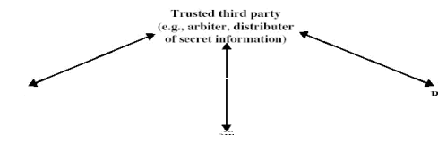

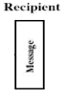
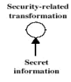


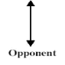
A Model Of Inter Network Security

Slide 38
In the above diagram Sender and Recipient are principals in the information transaction.
A logical information communication channel between source and destination for communicating the principals using communication protocols(ie. tcp/ip).
To protect information from an opponent, who may present a threat to confidentiality, authenticity so on. Messages need to encrypt at sender before sending and decrypt at recipient end after receiving.
Message at sender encrypt by security related message and transmitting through communication channel. The message will send with additional information like sender and encryption key.
Message at receiver will decrypt by security related message by using the security information like identifying sender and information key.
Encrypted message transmits over communication channel which is non-readable by opponent.

Slide 39
Basic tasks to design security service
There are four basic tasks to design a particular security service.
Design an algorithm for performing the security related information. Algorithm should be more complex to avoid opponent steeling the information.
Generate Secrete information to be used with the algorithm.
Develop methods for distribution and sharing of secrete information.
Specify protocols to be used by two principals that makes use of the security algorithm.

Slide 40
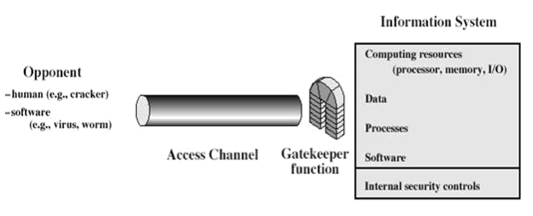

Slide 41
Internet Standards & RFP’s
Various organizations involved in the implementation of Internet.
Internet Society(ISOC)
Internet Architecture Board(IAB)
Internet Engineering Task Force(IETF)
Internet Research Task Force(IRTF)

Slide 42
Internet Society(ISOC)
internet society is responsible for development and publication of internet standards.
It is the actually a professional membership organization that supervises a large in internet development and standardization.
responsible for monitoring and coordinating internet design, engineering and management.
Three organizations under the internet society are responsible for actual work of standards development & publication.
1. INTERNET ARICHITECTURE BOARD (IAB): Responsible for defining the overall architecture of the internet, providing guidance and broad direction to IETF.
2. INETRNET ENGINEERING TASK FORCE (IETF): The protocol engineering and development arm of the internet.
3. INTERNET ENGINEERING STEERING GROUP (IESG): Responsible for technical management of IETF activities and the internet standards process

Slide 43
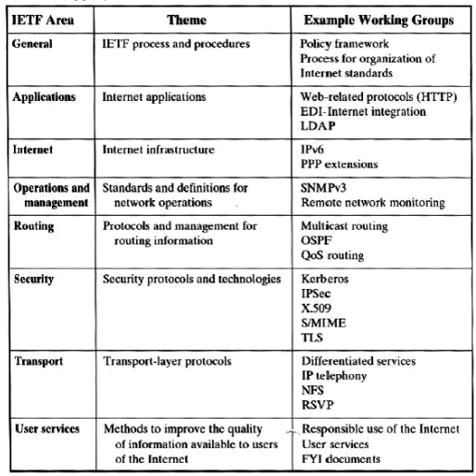
Internet Engineering Task Force(IETF)
The entire activities of the IETF are categorized into eight areas each having a categorized into eight areas each having it & numerous working groups.

Slide 44
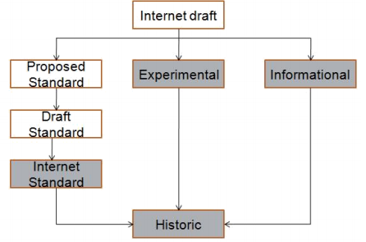
Internet Standardization Process
Creation of RFT by IETF
FC Approved by IESG

Slide 45
IETF group creates the initial document, and send to IESG group to validate as standard.
IESG validates the document based on the satisfaction of below criteria's
Be stable and easily understandable
Be technically competent
Have multiple, independent and interoperable implementations with substantial operations experience.
Enjoy significant public support.
Be recognizably useful in some or all parts of internet.
The RFC publication process starts after the approval of internet draft documentation as an RFC by IESG.
draft standard it must pass through at least two non- dependent interoperable implementations for achieving proper operational experience
implementations and operational experience is achieved, it can be regarded as internet standard

Slide 46
Buffer Over Flow(Attack on Memory)
Buffer is temporary area to storing data.
A buffer overflow occurs when a program or process tries to store more data in a buffer than it was intended to hold.
buffers are created to contain a finite amount of data, the extra information can overflow into adjacent buffers, corrupting or overwriting the valid data held in them/
Buffer flow may occur accidentally because of a programming error.
It happens when the attacker intentionally enters more data than a program able to handle.
The data runs over and overflows the section of valid data like part of programming instructions, user files, confidential information etc there by enabling the attacker’s data to overwrite it
This allows an attacker to overwrite data that controls the program and can take over control of the program to execute the attacker’s code instead of programmer’s code.

Slide 47
Void main()
{
char[10] name;
int number=5;
printf(“Enter your name:”);
scanf(“%s”,name);
printf(“Name is :”,name);
printf(“number:”,number);
}
Inputs: abcdefghi
Output will be : abcdefhi & 5
If input: abcdefghij
Output will be: abcdefhij and not 5

Slide 48
Void main()
{
int number=5;
while(number<5)
{
printf(“%d”,number);
}
}
Causes infinite looping and stack overflow.

Slide 49
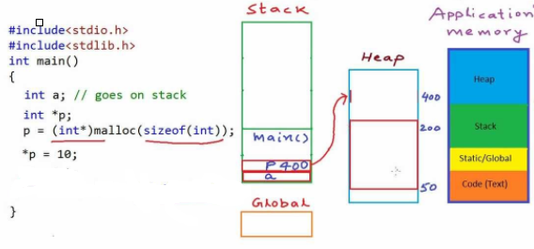
Overflow occurs in stack memory and heap memory.
All primitives, no-primitive data structures stores on stack memory.
Object type data and pointers data will store on heap memory, but the address of the objects or pointer will store on stack memory.

Slide 50
Format String Vulnerability( Attack on Programs)
Format string attacks can be used to crash a program or to execute harmful code.
some of the most commonly seen programming mistakes resulting in exploitable format string vulnerabilities.
Format string is an ASCII string used to specify and control the representation of different variables.
Format function uses the format string to convert ‘c’ data types into a string representation.
Int I; // allocates memory for I of integer size
i=10; // assign 10 value to the allocated memory of i
Printf(“%d is numer”,i); // gets value from memory and
convert to string and prints on the screen

Slide 51
Printf in ‘C’ is variodic function. It accepts variable number of arguments.
Printf function gets aurguments values from stack memory.
int a,b,c;
a=10;
b=20;
c= 30;
Printf(“%d %d %d”,a,b,c); // prints on screen
10 | 20 | 30

Slide 52
Vulnerability with printf.
1. Mismatching number of format specifiers and aurguments
Printf(“%d %d %d”,10,20);
Printf first %d gets 10 value and prints
and second %d gets 20 value and prints
and third %d tries to get value which is not available. Then it continuously tries fetches causes issue.
2. Input as format specifiers
#include<stdio.h>
Int main()
{
char name[10];
printf(“enter name”);
scanf(“%s”,name);
printf(“Ented name is %s”,name)
}
Notes:
for the above program. Valid input is name with less than or equals 10 characters.
If the user gives input %s instead of 10 characters string , will causes system crashes.

Slide 53
Hijacking
Spoofing or stolen the secret information to masquerading to access assets.
Hijacking
Network Level
Application Level
TCP Session Hijacking
UDP Session Hijacking
Http Hijacking

Slide 54
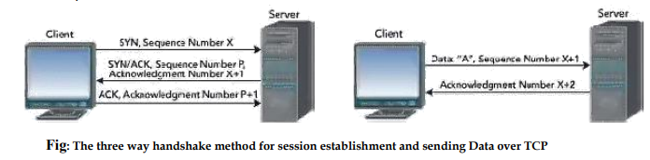
TCP Session Hijacking/ Session Hijacking
An Id or token generated by server, and shared to the authenticated(Logged in user) for subsequent access is called TCP Session/Session ID.
Objective of session to make sure communication between two parties by acknowledgement.
If attacker knows this session id, the he can masquerading as authorized user and do any thing like actual user.
Session id is normally stored with in cookies or url for most communication.
If web site does not respond in normal or expected way to user inputs or stop responding or all together for un known reason means session Hijacked by some attacker

Slide 55



TCP Session/Session Hijacking.
Request(SessionId:1234)
Response
(SessionId:1234)
Attacker

Slide 56
Client sends a synchronization (SYN) packet to the server with initial sequence number X.
Server responds by sending a SYN/ACK packet that contains the server's own sequence number p and an ACK number for the client's original SYN packet. This ACK number indicates the next sequence number the server expects from the client .
Client acknowledges receipt of the SYN/ACK packet by sending back to the server an ACK packet with the next sequence number it expects from the server, which in this case is P+1.

Slide 57
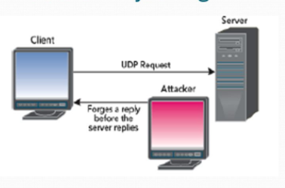
User Data Gram Protocol(UDP)
UDP does not have session state like TCP has, so there is no session to hijack.
Objective of the UDP is to improve the performance in communication but not care about delivery.
Example: broadcasting Live videos TV9,NTV or any other on youtube.
UDP does not use packet sequencing and synchronizing, it is easier than TCP to hijack UDP session.
Hijacker( attacker) snipping your network traffic understand the request and reply to the sender before actual server responding.

Slide 58
Your computer will assume that the spoofed response is real response, because there is no way to verify the identity of server.
UDP data example:
Media streaming (lost frames are ok)

Slide 59
Address Resolution Protocol(ARP)
Objective of the ARP (Address Resolution Protocol) is to flexibility to add new computer to LAN or remove existing computer from LAN based on the need.
ARP spoofing is a type of attack in which malicious actor sends falsified ARP message over a local area network(LAN), this results linking of the attacker’s MAC address with the IP address of computer or server on the network.
Once the attacker’s MAC address is connected to an authentic IP Address, the attacker will begin receiving any data that is intended for that ip address.
ARP spoofing can enable malicious parties to intercept, modify or stop data in transit.
ARP spoofing attacks can possible in LAN only.
ARP spoofing is serious implication for enterprises
Denial of Service
Session Hijacking
Man in the Middle(MITM) attack.

Slide 60
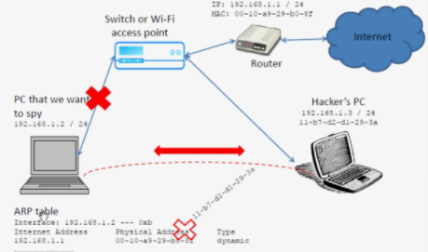

Slide 61
Route Table modification/Attack
A route table is set of rules in table format, that is used to determine where the data packet to deliver over internet protocol(IP) network.
All IP enable devices like routers and switches use the routing tables.
Basic Routing table includes the following information.
Objective of the route table to identify the path to reach actual destination.
Route table columns
Destination IP | Next Hop | Interface | Metric | Routes

Slide 62
Destination : IP address of the final destination , to chick the packet need to deliver
Next Hop: the IP address to which the packet is forwarded.
Interface: the out going network interface the device should use when forwarding the packet to net hop or final destination.
Metric: assigns a cost each available route so that the most cost-effective path can be chosen.
Routes: includes directly attached subnets, indirect subnets that are not attached to device but can be accessed through one or more hops, and default routes to use for certain types of traffic or when information lacking.

Slide 63
Purpose of the Route Table Modification is to restrict some sites access in the Organization.
Example most of the companies not provide access to social networking site in the organization.
Attacker may access the route table content and changes destination or next hop to divert the request to his computer.

Slide 64
Man in the Middle(MITM)
Objective of the Man In the Middle to assuring the data integrity and audit etc.
MITM attacks happens when a communication between two systems is interconnected by outside entry.
MITM attack can happens in any form of online communication such as email, social media or web surfing.
Attacker not only try to eavesdropping on private conversation, they can also target all the information inside your device.
Hackers will setup a wifi connection with attractive or user interested name. when any person tries to connect wifi, hacker will provide access. After that, when user do any transaction, hacker will intercept and steel the personal informaion.

Slide 65
